Slide 1
Musculoskeletal deficiencies student’s Name institutional affiliation
Supracondylar Fracture

Slide 2
Supracondylar Fracture
A supracondylar fracture is an injury to the humerus just above the elbow joint.
It is the most common type of elbow fracture in children under 7 years old.
Supracondylar fractures are very rare in adults.
They account for up to 60 percent of pediatric elbow fractures.
Supracondylar fractures are frequently caused by a fall on an outstretched elbow.
Complications of supracondylar fracture include injury to nerves and blood vessels.
Notes:
A supracondylar fracture is an injury to humerus just above the elbow. It is common in children 5-7 years of age. Such fractures are mainly caused by a fall on an outstretched elbow.

Slide 3
Symptoms of supracondylar fracture
Swelling around the elbow.
Numbness in the hand
Inability to straighten or move the arm
Sudden intense pain in the forearm and elbow
Notes:
Common symptoms of supracondylar fracture are numbness in the hand, swelling around the elbow, inability to move the am and sudden intense pain in the elbow.

Slide 4
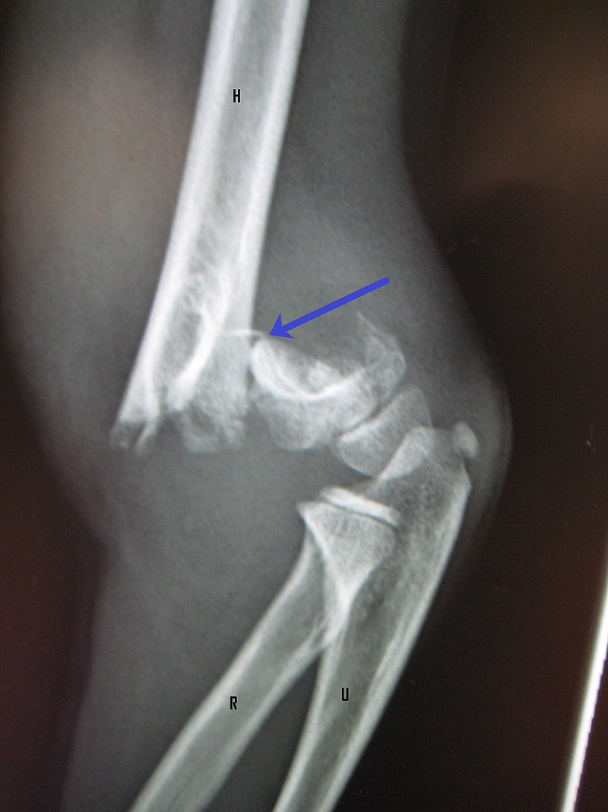
Photograph showing a supracondylar fracture in a young child

Slide 5
Risk factors for supracondylar fractures
Supracondylar fractures are most common to children
They are more common to boys than girls
The injury is more likely to occur during summer
They require surgery

Slide 6
What the doctor looks for during examination
The doctor looks for any swelling or bruising
Limitation of movement
Tenderness around the elbow
Possibility of damage to blood vessels and nerves
Possibility of multiple fractures around the elbow
Restriction of blood flow indicated by a change in color of the hand.
Notes:
During examination, the doctor looks for: any swelling or bruising, limitation of movement, tenderness around the elbow, possibility of multiple fractures around the elbow and possibility of damage to blood vessels and nerves.

Slide 7
Diagnosing supracondylar fractures
Supracondylar fractures can be diagnosed using X-ray imaging.
A computed tomography (CT scan) is also used to give a 3D image of the affected area.
Magnetic resonance imaging (MRI) is used to show more details if the fracture is small.
The doctor uses X-rays to determine where the fracture has occurred and to distinguish supracondylar fractures from any other type of fractures.
The doctor then classifies the type of fracture using the Gartland system.
In case of an extension fracture, the humerus has been pushed backward from the elbow joint.
In case of a flexion injury, it means that the injury has been caused by a rotation of the elbow.
Notes:
Supracondylar fractures can be diagnosed through X-ray imaging, CT scan, and Magnetic resonance imaging. The Gartland system is used to classify fractures.

Slide 8
Classification of supracondylar fractures
Type 1: represents non-displaced fractures
Type II: angulated with intact posterior context
Type III: complete displacement but have lateral contact. Humerus severely displaced.
Type IV: periostial disruption with in both extension and flexion. Humerus severely displaced.
Notes:
Supracondylar fractures are classified into Type I, Type II, Type III and Type IV depending on their severity.

Slide 9
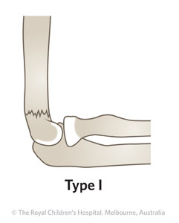
Type I fracture
Notes:
This photo represents type I fracture. It shows undisplaced fracture.

Slide 10
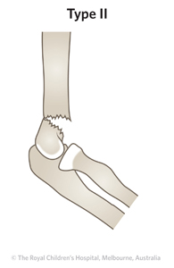
Type II fracture
Notes:
This is Type II fracture showing angulated fracture with intact posterior cortex.

Slide 11
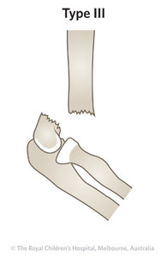
Type III fracture
Notes:
This is a type III fracture showing complete displacement with no cortical contact.

Slide 12
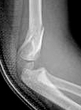
Gartland type II with coronal plane deformity

Slide 13
Treatment
Treatment depends on the type and severity of the injury. Treatment methods include:
Closed reduction and percutaneous pinning (CRPP) is used to treat type II and III supracondylar fractures, and flexion type.
Type IV is treated mostly with CRPP or open reduction if needed.
CRPP involves not only resetting the bones but also inserting pins through the skin to rejoin the fractured parts of the bone.
Open reduction with internal fixation is applied when the displacement is very severe or there is damage to blood vessels or nerves.
Notes:
Treatment is determined by the severity of the injury. Treatment methods include CRPP, and open reduction with internal fixation.

Slide 14
Potential complications associated with supracondylar fractures
Gartland type II injuries are rarely associated with neurovascular problems. It may however, result in malunion or gunstock deformity.
Gartland type III injuries have the highest risk of neurovascular injury.
Cubitus valgus which is caused by fracture malunion
Recurvatum complications associated with non-operative treatment of Type II and Type III fractures.
Pin migration which is the most common complication.
Notes:
Complications associated with this type of fracture include malunion, gunstock deformity, cubitus valgus, recurvatum, and pin migration.

Slide 15
Conti…
Volkmann ischemic contracture. This is a rare but dreaded complication which may result from elbow hyper flexion casting.
Postoperative stiffness complication
Vascular injury
Notes:
Other complications are Volkmann ischemic contracture, postoperative stiffness and vascular injury.

Slide 16

The photograph shows someone suffering from supracondylar fracture

Slide 17
Recovery
The child will need to wear a splint for three to six weeks
The splint helps to elevate the injured elbow
Visit the doctor regularly to make sure the fractured bone is rejoining properly.
The doctor may recommend for exercises to improve the elbow range of motion as healing continues.
Wear loose-fitting shirts and let the sleeve on the cast side hang free.
Notes:
In order for your child to recover well, it will need to wear a splint for 3-6 weeks, visit the doctor regularly, wear loose-fitting shirts and do more exercises.

Slide 18
What to do after surgery
Some pain is likely to be felt after the pins and cast are in place. Pain relievers such as ibuprofen, Tylenol and aspirin may be helpful for relieving the pain.
Pins should be removed by the doctor 3-4 weeks after surgery. There is no need for anesthesia.
Total recovery time varies but typically if pins were used, recovery time ranges from six to seven weeks.
The child may return to school within 3-4 days after surgery but they should abstain from playing and other sports.
Notes:
After surgery be sure to take pain relievers like aspirin and Tylenol, remove pins after 3-4 weeks, and abstain from sport activities.

Slide 19
My advice to parents
For Gartland type I fractures, parents should be given undisplaced supracondylar fracture fact sheet.
Manage your child in a sling for 3 weeks.
Emphasis should be placed on elevation of the arm.
The bakslab and sling should be worn under clothing like a loose fitting shirt and not through the sleeve.

Slide 20
references
Labelle, H., Bunnell, W. P., Duhaime, M., & Poitras, B. (1982). Cubitus varus deformity following supracondylar fractures of the humerus in children. Journal of pediatric orthopedics, 2(5), 539-546.
Otsuka, N. Y., & Kasser, J. R. (1997). Supracondylar fractures of the humerus in children. JAAOS-Journal of the American Academy of Orthopedic Surgeons, 5(1), 19-26.
Pirone, A. M., Graham, H. K., & Krajbich, J. I. (1988). Management of displaced extension-type supracondylar fractures of the humerus in children. The Journal of bone and joint surgery. American volume, 70(5), 641-650.

